Slide 1
DSA PROJECT MARKET STORE SYSTEM
NAME: MUHAMMAD IBRAHIM RAHPOTO
ROLL NO: 19SW12

Slide 2
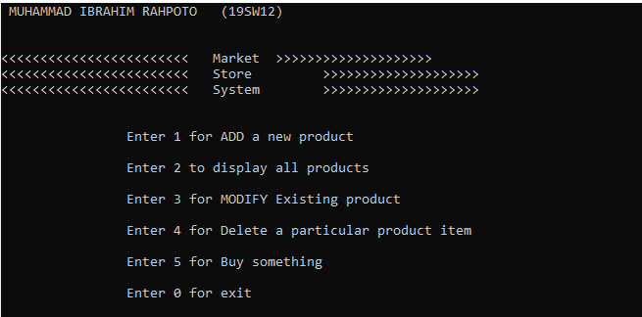
INTRODUCTION
NAME : MARKET STORE SYSTEM
DATA STRUCTURE : LINKED LIST
FEATURES :
1, Add a new product
2, Modify existing product
3, delete a particular product item
4, Display all the products
5, Buy something

Slide 3
IDENTIFICATION OF PROBLEM
As my project is based on market store system
In this project we can add a new product , delete a particular product and display all the existing products and if we want we can modify a product with the help of product ID. So in all cases we need a data structure.

Slide 4
WHICH DATA STRUCTURE IS NEEDED
As we know that when we have to manage our data and if we have to organize it in a meaningful way , we use data structure for that purpose.
Linked List are used to complete this project.
We have to manage the products with product ID and all these functionalities like add new product ,delete a particular product and modify the product are performed with the help of product ID.
Product name, price and quantity link with product Id, so Linked List is preferably used in this project.

Slide 5
WHY DATA STRUCTURE IS USED:
Data structure is necessary for all those projects which stores its data.
Data structure is needed to shape particular data in an organized manner
So in my project also data structure is necessary because this project add new product , delete a product and modify a product for this purpose data structure is needed because this all can be done easily through a data structure.

Slide 6
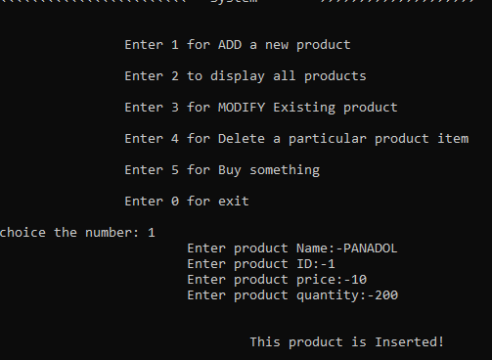
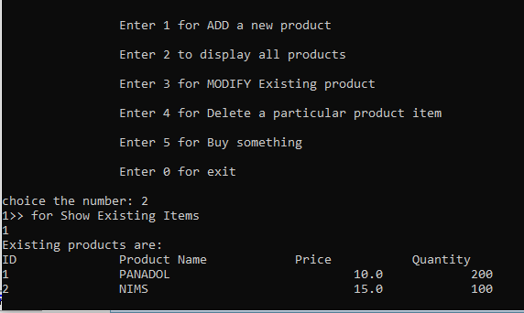
COMPLETENESS
In my project , functionalities are working properly.
ADD A NEW PRODUCT DISPLAY ALL PRODUCT

Slide 7
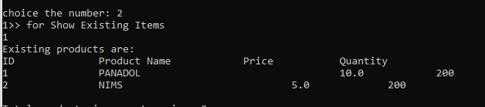
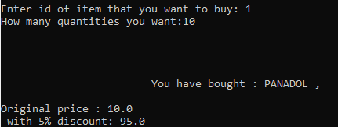
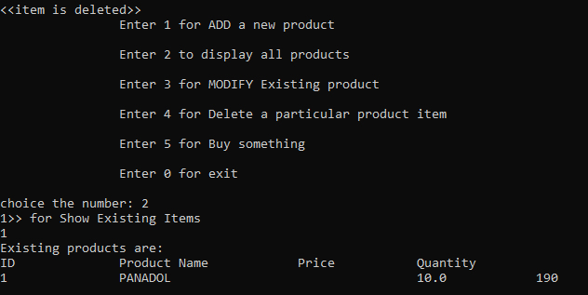
MODIFY A PRODUCT BUY
DELETE A PRODUCT

Slide 8
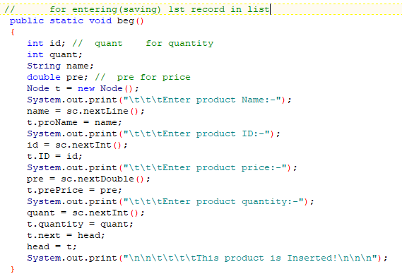
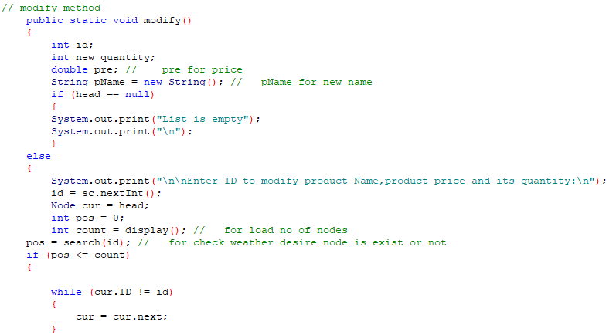
Code :

Slide 9
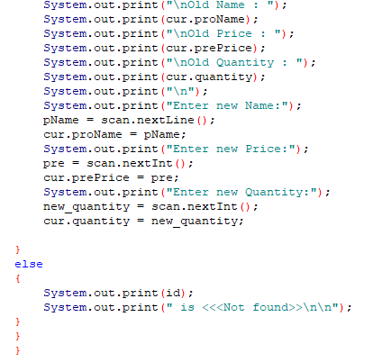

Slide 10
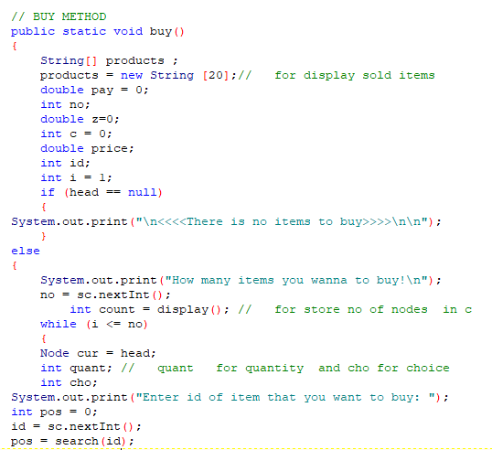
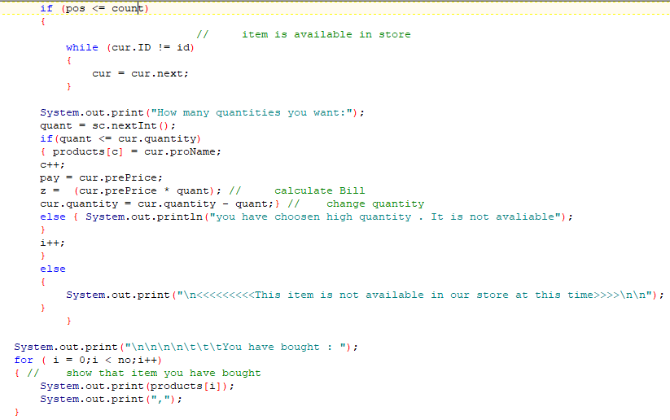
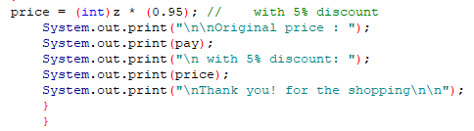

Slide 11
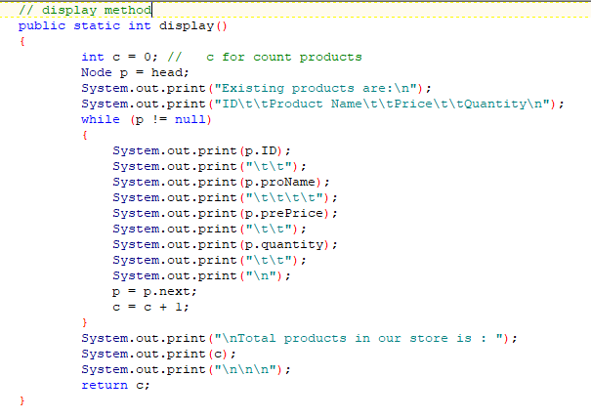
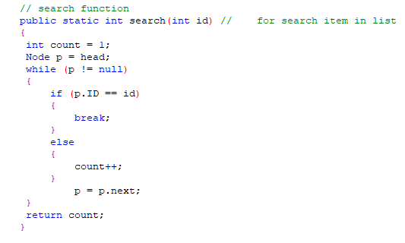

Slide 12
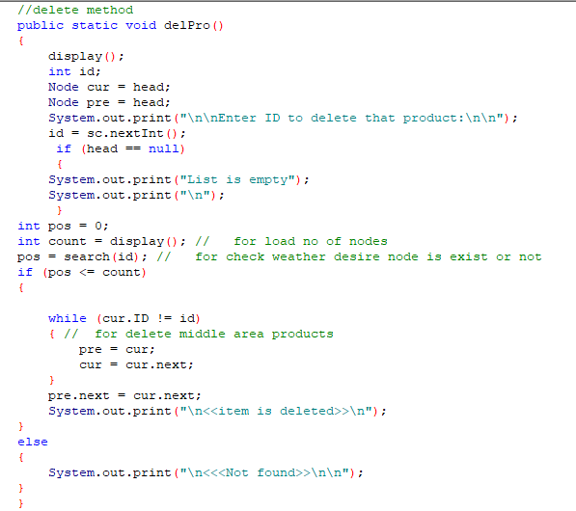
THANK YOU ☺

